Slide 1

Visvesvaraya Technological University BelAgaVI-590014
PARKING SLOT DETECTION USING MATLAB Report
Submitted By
Anuradha Dixit (1DT18EC015)
Chaitra B P (1DT18EC027)
Jalla Swathika (1DT18EC036)
Kavya A J (1DT19EC406)by
Under the Guidance of
Mr. SYED ATEEQUR REHMAN
(Asst. Professor, Dept. of ECE)
Department of Electronics and Communication Engineering
DAYANANDA SAGAR ACADEMY OF TECHNOLOGY AND MANAGEMENT
Udayapura, Kanakapura Road, Bangalore-560082
2020-2021

Slide 2

OUTLINE
INTRODUCTION
LITERATURE SURVEY
PROBLEM STATEMENT
OBJECTIVES
BLOCK DIAGRAM
BLOCK DIAGRAM EXPLANATION
SOFTWARE/HARDWARE
RESULTS AND DISCUSSIONS
APPLICATIONS
ADVANTAGES
CONCLUSIONS
REFERENCES

Slide 3
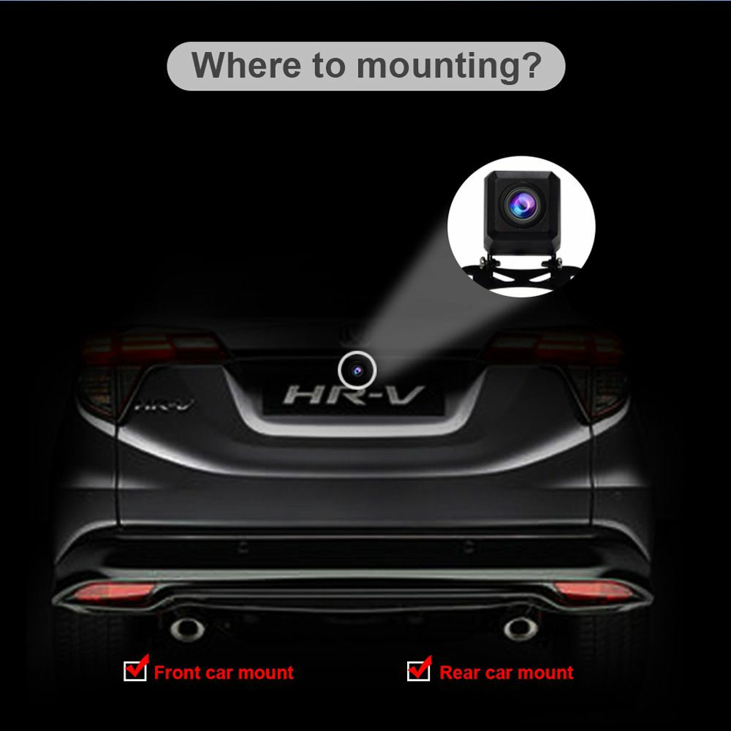
INTRODUCTION
Due to urbanization, the population in metropolitan areas is sharply increasing.
One result of this is an increase in traffic in these centers. More parking spaces will be needed to deal with the increasing number of cars.
This problem might be addressed by giving car parks new structures that allow autonomously driven cars to use them.
Most of the automatic parking systems on the market designate target positions using a free space-based approach that involves the use of ultrasonic sensors.
However, these depend on the presence and alignment of adjacent vehicles.
Visual sensors are widely used in automatic parking systems, so this presentation proposes an algorithm for the visual detection of available parking slots.
The proposed system consists of two stages:
Parking slot recognition and
Slot occupancy classification.

Slide 4
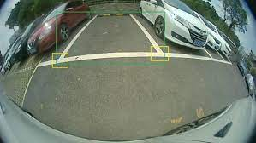
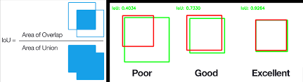
Continues….
The parking slot recognition stage generates parking slots using the corner features
of parking slot markings.
The slot occupancy classification stage verifies the availability of the parking slot using the features of detected slots. The experimental results demonstrate that the proposed method effectively detects available parking slots in AVM images.
Parking slot recognition stage Slot occupancy classification
“This system assumes that a driver selects the right side to park because most countries driver seat will be on the right. Therefore, the system only utilizes the right half of the AVM images”.

Slide 5
LITERATURE SURVEY
SL.NO. | AUTHORS | TITLE | OUTCOME | DISADVANTAGES | YEAR OF PUBLICATION
1
Kaempchen
Stereo vision based method
Only relies on parking lot markings
IEEE 2018
Three dimensional fitting of a vehicle plane method
2
Xu et al
Parking space marking based on RCE colour segmentation
Degraded due to poor visual conditions such as strains, shadows from adjacent vehicles on the markings
IEEE 2018
Contour extraction by the least square method, and inverse perspective transformation theory
3
Zain Rajani, Michelle Araujo-e-Vegas
MATLAB method called subtraction method between consecutive images
Smart parking space detection using MATLAB and IOT
Number of empty spaces can be shown but not where exactly they are
IEEE 2017

Slide 6
Continues…
 |  |  | Smart PARKING System for Locating Vacant Parking slots | Time consuming | IEEE 2018
4
Akshay Nilam, Priyanka Patil, Shruthi Shinde, Sippora Toppo
Image processing by capturing the parking area photos from CCTV
5
Jian-Yu Chen and Chih-Ming Hsu*,
A visual method for the detection of Available Parking Slots
Effectively detects the available parking slots in AVM images.
IEEE 2018
Does not work well when the parking slot markings are severely damaged because it uses the outputs from optical sensors.

Slide 7

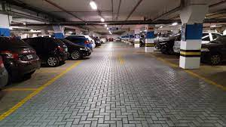
PROBLEM STATEMENT
We know that Parking is one of the most important problem in the metropolitan cities. In such big cities, It is common for most of the people’s to have four wheeler’s. They always face the problem of parking.
In big applications like mall, offices, companies etc., the slots in the corner of the parking zone many times get wasted, since it is difficult to detect such corners,
It becomes very tedious work to keep a note of how many parking places are free or how many parking spaces are available. They must exactly know how many free slots they have to allot to car’s who have to park.

Slide 8
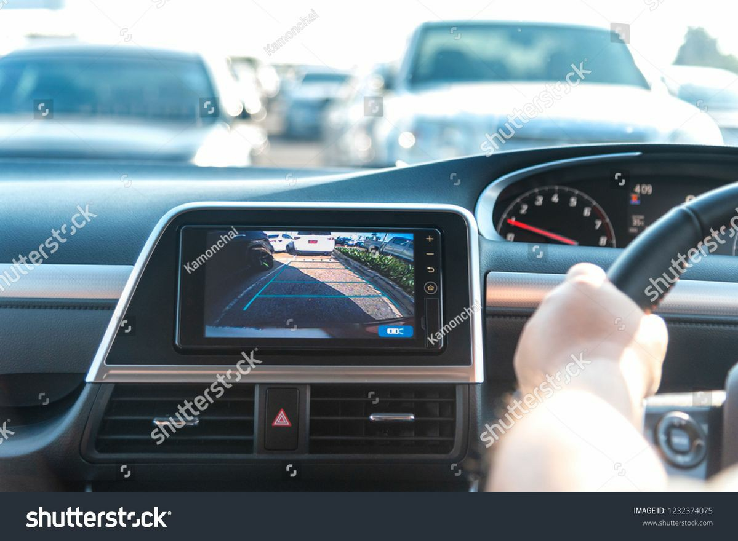
OBJECTIVE
The aim of implementing Parking slot detection using MATLAB is to reduce time and increase efficiency of the current Parking Management System. In overpopulated cosmopolitan zones, parking strategies must be well implemented for management of vehicles.
The system provides details of the vacant parking slots in the vicinity and reduces the traffic issues due to illegal parking in the vicinity. It is designed with an objective to meet the requirements of controlled parking that offers effortless parking tactics to the authorities.
To include addition concept of detecting the object
(here the object is empty slot in parking).
To overcome the problem of identifying whether the slot
is empty or not by sitting at once place with less consistency.

Slide 9
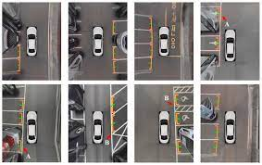
Continues…
For reducing the circuitry this method of detecting the empty slot in parking zone by using the MATLAB code the image processing has become very easy with the reduction in number of circuitry.
To identify that the digital technology can be used to detect the slots.
Using the image processing feature of MATLAB for determining the empty space.
To overcome large number of circuitry we are using the MATLAB GUI. It makes circuitry very simple and with minimum amount of circuitry.

Slide 10
BLOCK DIAGRAM
Feature Extraction
Slot Selection
AVM Images
Slot Feature Extraction
Feature Classification
Pavement
Non Pavement
Guide Line Recognition
Separating line recognition
Parking slot recognition
Naive Bayes Classifier
Slot occupancy classification
Parking slot recognition stage
Slot Occupancy Classification Stage

Slide 11
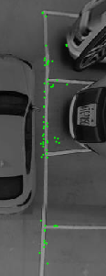
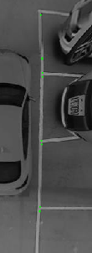
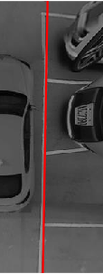
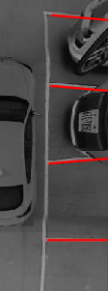
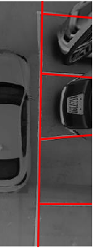
BLOCK DAIGRAM EXPLANATION
Feature Extraction
Rectangular parking slot markings consist of a single guideline and multiple separating lines that are perpendicular to the guide line. This paper uses a FAST corner detector and not a Harris corner detector, because computation time is reduced.
Feature Classification
The image is firstly converted to a binary image, to allow the markings to be more easily distinguished. The proportions of the parking slot markings and the pavement ate then calculated. Finally, the proportions of each corner are determined to be acceptable or not.
Guide Line Detection
To detect the guide line, the proposed method uses the corner features at the junction points of parking slots. Since the corners inevitably include outliers, the proposed method uses RANSAC to give a more robust estimation.
(a)feature extraction,
(b)feature classification, (c)guide line detection, (d)separating line detection (e)parking slot recognition.
a
b
c
d
e

Slide 12
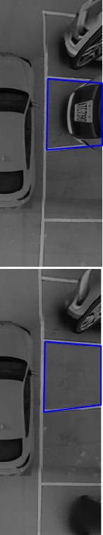
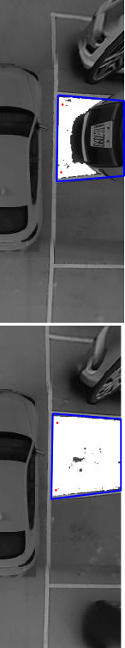
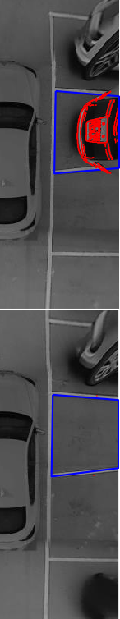
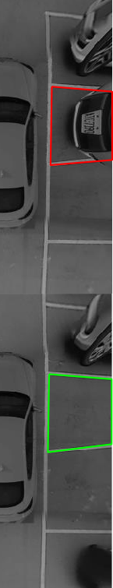
Continues..
Detection of the Separating Line
To accurately estimate the separating line, the proposed method takes account
of the fact that there are two parallel lines at a fixed distance whose gradient
directions are opposite to each other.
Each separating line also has a fixed
distance.
Slot Selection
When the parking slot has been recognized, the availability of the detected
slots must be determined. The distortion in AVM images is worse at
locations that are far from camera so the tested slot might be the slot
that is nearest the camera.
Slot Feature Extraction
Slot features are used to analyze the slot’s context and to determine slot occupancy.
The proposed method analyzes the slot from two aspects: pavement and non-pavement.
The area of pavement for the slot is used to determine the slot’s availability.
Slot occupancy classification procedure for an occupied slot (first row) and a vacant slot (second row). (a)-(d) respectively show the results for slot selection, region growing, edge detection and classification using a naive Bayes classifier.

Slide 13
Continues..
Occupancy Classification using a Naive Bayes Classifier
When the features of slot are extracted, the proposed method classifies the occupancy of the tested slot by using a naïve Bayes classifier. A naive Bayes classifier is a practical probabilistic classifier that has found many applications. It assumes that each feature of a particular class is independent of any other feature. The posterior probability of parking slot occupancy is calculated using Bayes’ theorem, as follows:
𝑝(𝐶𝑖 |𝐹) = 𝑝(𝐶𝑖)𝑝(𝐹|𝐶𝑖) 𝑝(𝐹) (1)
Where 𝐶𝑖 indicates the class of slot availability: occupied or vacant.
𝐹 indicates the features of the slot, including the region growing ratio and the number of edges.
To reduce the computation time that is required to estimate 𝑝(𝐹|𝐶𝑖) , the classifier uses the attributes that are conditionally independent of each other. Therefore,
𝑝(𝐹|𝐶𝑖 )=∏𝑝(𝑓𝑘 |𝐶𝑖 ) 2 𝑘=1 (2) To estimate the class label for F, 𝑝(𝐶𝑖)𝑝(𝐹|𝐶𝑖) is evaluated for each class, 𝐶𝑖 .
The classifier identifies the class label for feature F using the maximum a posteriori (MAP) rule:
CLASS = argmax 𝑖∈{1,2} 𝑝(𝐶𝑖)∏𝑝(𝑓𝑘|𝐶𝑖) (3)
2
K=1

Slide 14
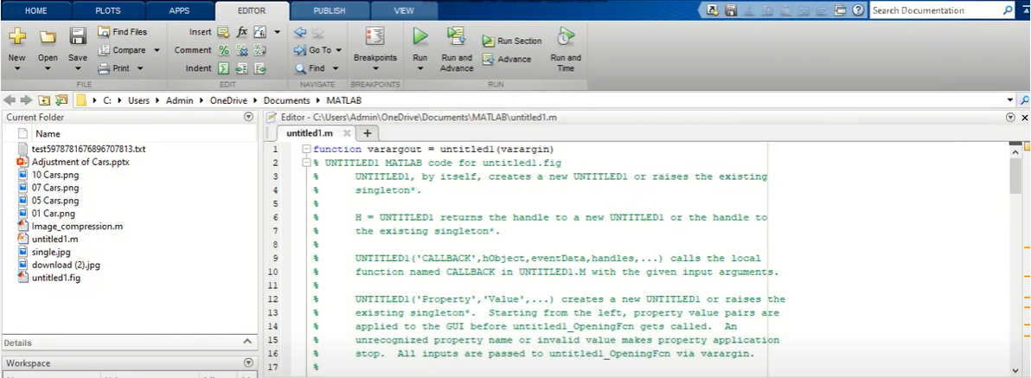
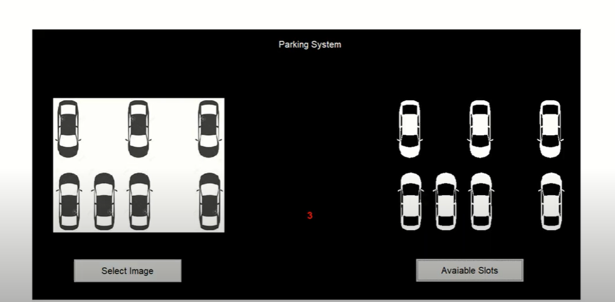
SOFTWARE/HARDWARE
There are number of circuitry can be involved in this technique.
To overcome large number of circuitry, this method of detecting the empty slot in parking zone by using MATLAB (image processing) code has become easy with the reduction in circuitry.
The conceptualization of this project is based on software instead of hardware which makes the system cheap to maintain and implement.

Slide 15
RESULTS AND DISCUSSION
Experimental Setup:
The dataset that was used in the experiments was acquired using an AVM system.
An AVM system consists of four cameras that are located at the centers of the front and rear bumpers and under the side-view mirrors.
The resolution of the AVM image is 700 × 520 pixels. All methods were run on MATLAB.
Evaluation:
Parking slots with a green or a red box respectively represent vacant and occupied parking slots. Table I shows the parking slot recognition performance for the proposed method. Table II shows the slot occupancy classification performance for the proposed method. Recall and precision, as defined in (4) and (5), are the performance measures.
Recall =no. of correctly detected slots/no. of existing slots
Precision =no. of correctly detected slots/no. of detected slots
(4)
(5)

Slide 16
Continues…
TABLE 1
PERFORMANCE FOR THE PROPOSED PARKING SLOT RECOGNITION METHOD
Slot type # of existing slots # of detected slots # of correctly slots recall precision
Rectangular 489 489 484 98.9% 99.5%
TABLE 2
PERFORMANCE FOR THE PROPOSED SLOT OCCUPANCY CLASSIFICATION METHOD
Slot type # of occupied slots (positive) # of vacant slots (negative) #of false negative #of false positive
Rectangular 85 85 0 1
Error rate=0.6%

Slide 17
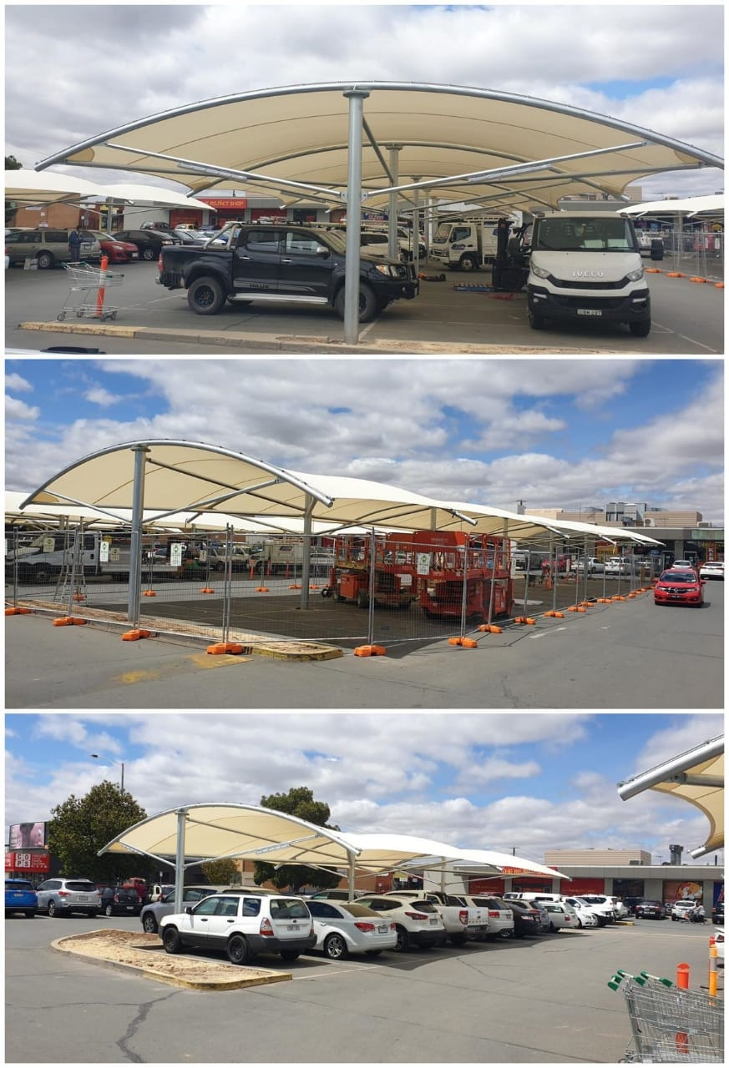
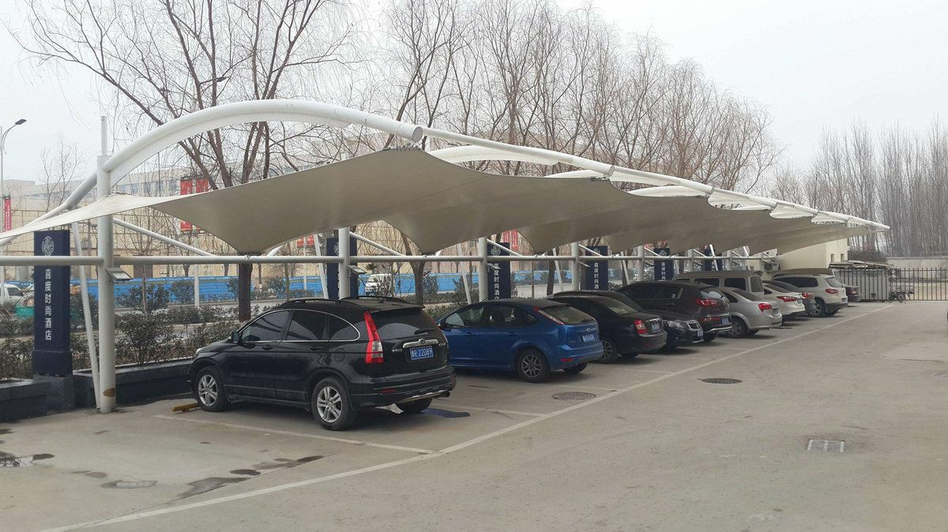
APPLICATIONS
In big applications like malls and offices, the slots in corner of the parking zone many times get wasted because it is very difficult to detect such corners. So its main applications is in large places where much of crowd is gathered on daily basis.
For example, airports, malls, etc…

Slide 18



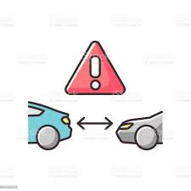
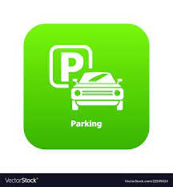
ADVANTAGES
Space saving
Optimum utilization of space
Can be built below or above ground or a combination there off
Cost Effective Safety vehicles
Lower construction cost Avoids theft of the vehicles
Lower maintenance and operational cost Less chances of damages or dents
Time saving
Low parking/retrieval times
of 45-150 seconds per car
Green parking
Reduced noise and vehicular pollution
Reduced traffic congestion

Slide 19
CONCLUSION
Uses the visual method (AVM-AROUND VIEW MONTIOR) which has four cameras that are located at the centers of the front and rear bumpers and under the side-view mirrors.
We are implementing this method since it effectively detects the available parking slots in AVM images.
This presentation presents a visual-based algorithm for the detection of available parking slots in images that are acquired by an AVM system.
It is shown that parking slots are recognized using RANSAC and the corner-based detection of slot markings and slot occupancy is effectively classified by analyzing the pavement and non-pavement features of slots.
The system benefits of smart parking go well beyond avoiding time wasting
Developing a smart parking solutions within the city solves the pollution problem.
The system benefits of smart parking go well beyond avoiding the needless circling of city blocks.
It also enables cities to develop fully integrated multimodal intelligent transportation systems that don’t rely on cars in the first place.

Slide 20
REFERENCES
REFERENCES:
Zain Rajani, Michelle Araujo-e-Vegas, “Smart Parking Space Detection Using MATLAB and Internet of Things”.
Akshay Nikam, Priyanka Patil, Shruti Shinde, Sippora Toppo, “Smart Parking System for Locating Vacant Parking Slots”.
Jian-Yu Chen and Chih-Ming Hsu*, “A visual method for the detection of Available Parking Slots”.

